Slide 1

Roadside Vegetation Barrier Designs to Mitigate Near-Road Air Pollution Impacts
K. Max Zhang
Sibley School of Mechanical and Aerospace Engineering
Cornell University

Slide 2
Acknowledgments
Current and former PhD students working on this subject: Zheming Tong, Jon Steffens, and Bo Yang
Valuable discussions with Drs. Rich Baldauf, Vlad Isakov and Parik Deshmukh at USEPA
Experimental data from USEPA

Slide 3


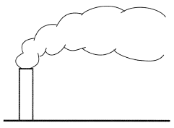


Relevant Properties and Processes
Leaf area density/porosity
Drag coefficient
Width, height
Barrier layout
VOC emissions
Wind speed, direction
Atmospheric stability
Dispersion
Deposition
Aerosol dynamics and gas chemistry
Highway geometry
Road properties
Traffic conditions (volume, mix, etc.)
Surrounding structures
Particle size distribution
Concentrations of air toxics
Human exposure
Design parameters

Slide 4
More on the Atmospheric Processes
Dispersion
  Solid barrier effect: creating upward momentum and enhancing plume dispersion -> lower ground level conc. behind the barrier
  Windbreak effect: plume going through the canopy at slower speed -> higher ground level conc.
  On-road accumulation: higher on-road conc., but lower ground level conc. behind the barrier
Deposition
  Size dependent
  Time dependent
  Re-suspension?
Aerosol dynamics and gas chemistry

Slide 5
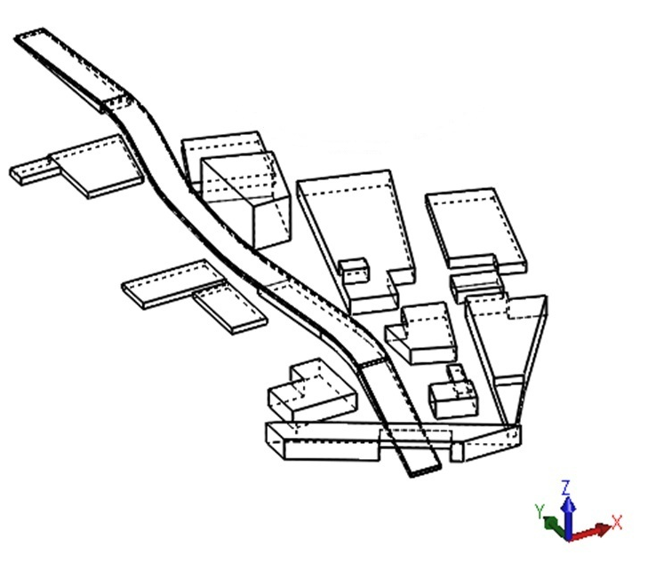
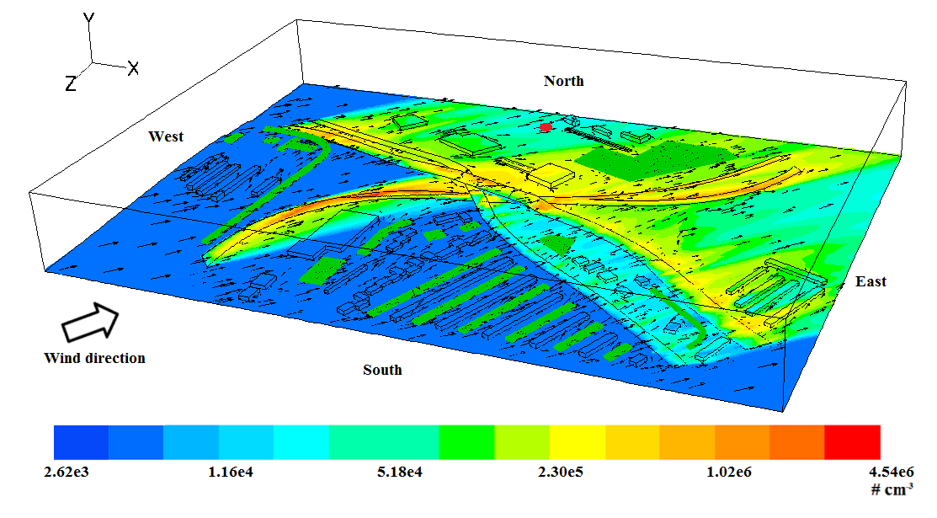
Comprehensive Turbulent Aerosol and Gas Chemistry (CTAG)

Slide 6
Past work on Transportation and Air Quality

Slide 7
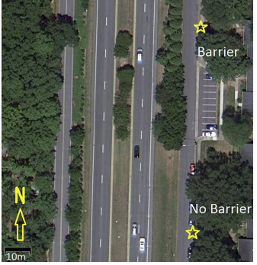
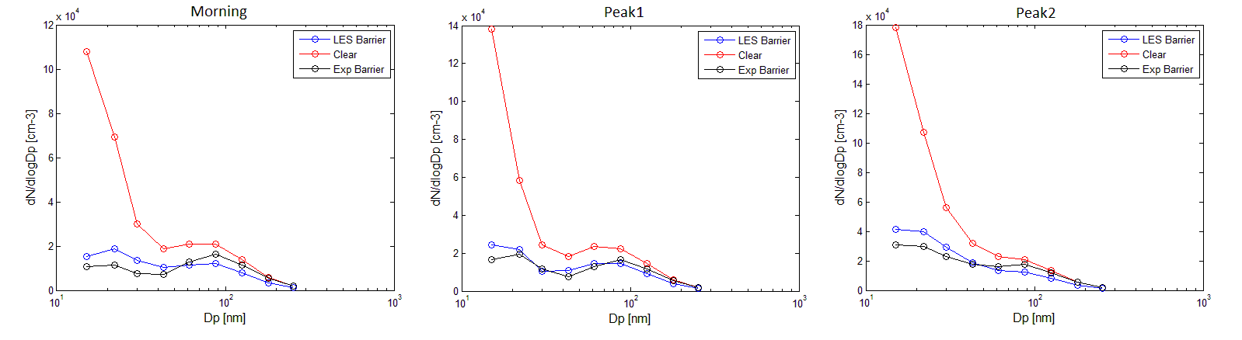
Revisiting Chapel Hill Experimental Dataset with
Large Eddy Simulation (LES)
The Chapel Hill (NC) dataset was collected by USEPA and Duke researchers (Hagler et al., 2011).
Steffens et al. (2012) employed RANS turbulence model and two different particle deposition models to simulate the dataset.
We recently applied the Large Eddy Simulation (LES) model to re-simulate the dataset.
LES model shows generally good agreement.
Tong et al., manuscript in preparation

Slide 8
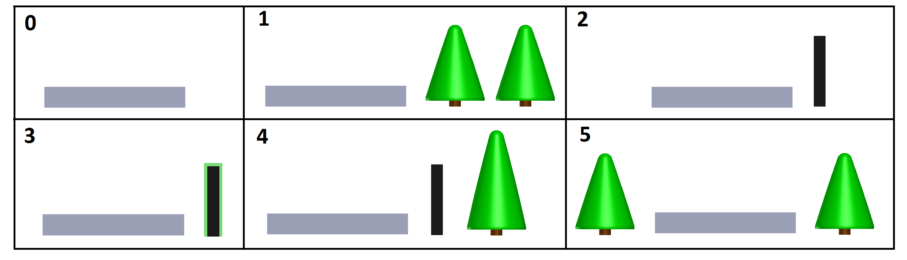
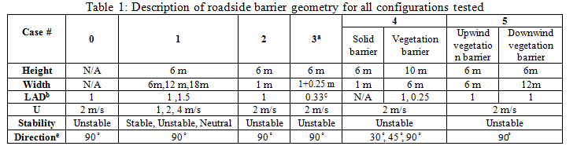
Design Configurations
Tong et al., manuscript in preparation

Slide 9
Main Assumptions
Highway conditions are taken as the same as those in the Chapel Hill experiment
Infinite long barrier
Baseline case:
  Leaf area density and drag coefficient taken from the Chapel Hill experiment (conifer)
  Perpendicular wind direction

Slide 10
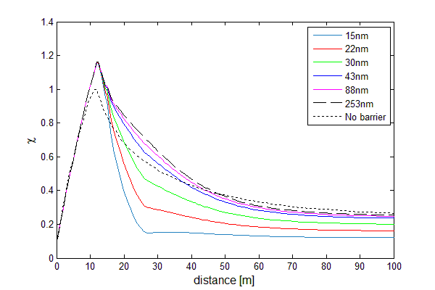
Case 1: Horizontal Gradient
Baseline Top View
15m
Tong et al., manuscript in preparation

Slide 11
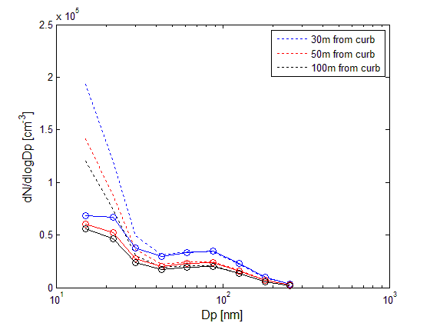
Case 1: Particle Size Distribution
Tong et al., manuscript in preparation

Slide 12
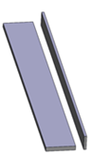
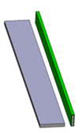

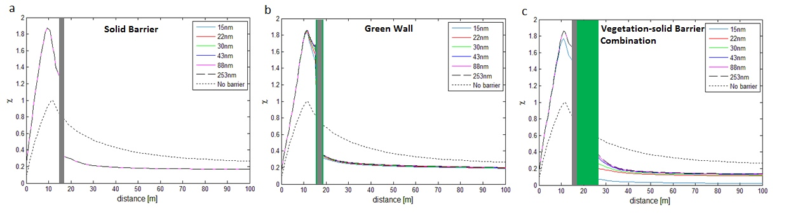
Cases 2, 3, 4: Solid, Green Wall and Combination
Solid barrier: significant reduction in conc. behind the barrier with on-road accumulation
Green Wall: Slight more reduction compared to the solid barrier case
Vegetation-solid barrier combination: greatest reduction in conc. behind the barrier with on-road accumulation
Tong et al., manuscript in preparation

Slide 13
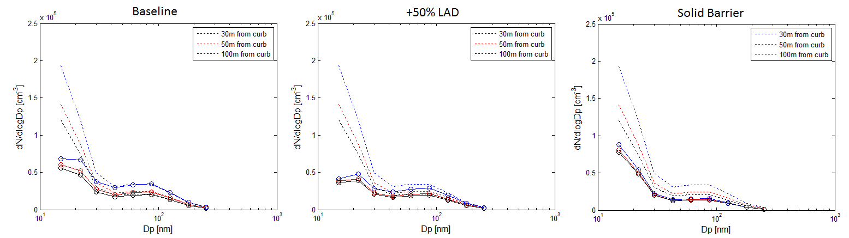
Sensitivity: Leaf Area Density (LAD)
Increasing LAD
Increasing LAD leads to more deposition and upward momentum
  For smaller particles, greater reduction behind the barrier
  For larger particles with relatively small deposition velocity, approaching the behaviors of a solid barrier
Tong et al., manuscript in preparation

Slide 14
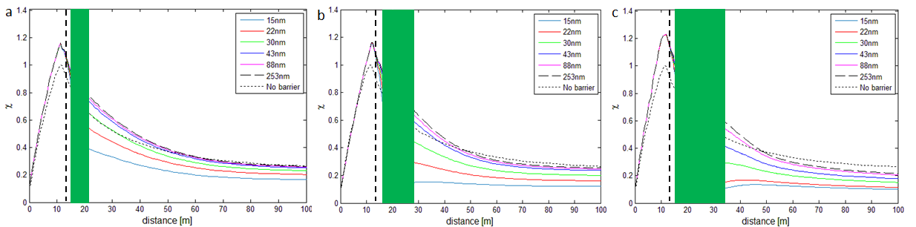
Sensitivity: Barrier Width
Increasing width
Increasing width leads to more deposition
  For smaller particles, greater reduction behind the barrier
  For larger particles with relatively small deposition velocity, earlier transition to lower conc. compared to the no-barrier case
On-road accumulation is modest compared to solid barrier
Tong et al., manuscript in preparation

Slide 15
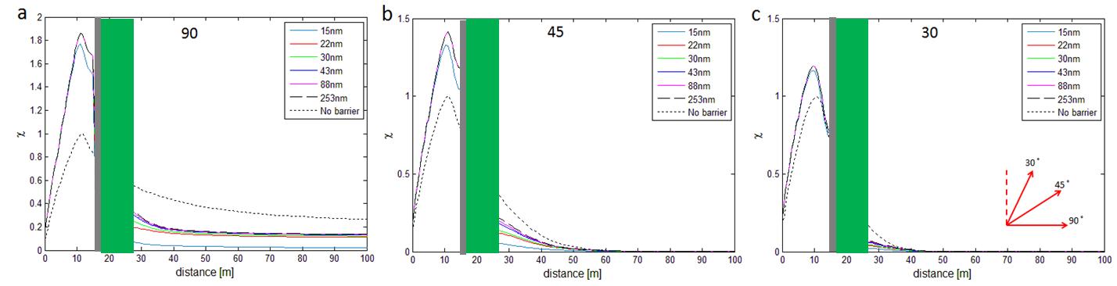
Sensitivity: Wind Direction
The degree of on-road increase is contingent on oncoming wind direction.
The on-road concentration decreases with more parallel wind to the road
Tong et al., manuscript in preparation

Slide 16
Edge Effects
Steffens et al. (2014)
Steffens et al. (2013)

Slide 17
Report Card for Model Capability
Modeling results capture the general phenomena very well
  Vegetation-solid barriers show greatest reduction
  Wider and denser trees lead to more reduction
  Edge effects can be captured
  …
Research needs
  More testing against different vegetation barrier configurations, meteorological and traffic conditions
  Turbulence modeling: drag vs. wind speed
  Deposition modeling
  Effects of vegetation barriers on near-source chemistry and regional ozone chemistry
  Parameterization
  …

Slide 18
The effect of wind direction on on-road concentrations
White: On-road; Shaded: Barrier
Baldauf et al., manuscript under review

